Slide 1
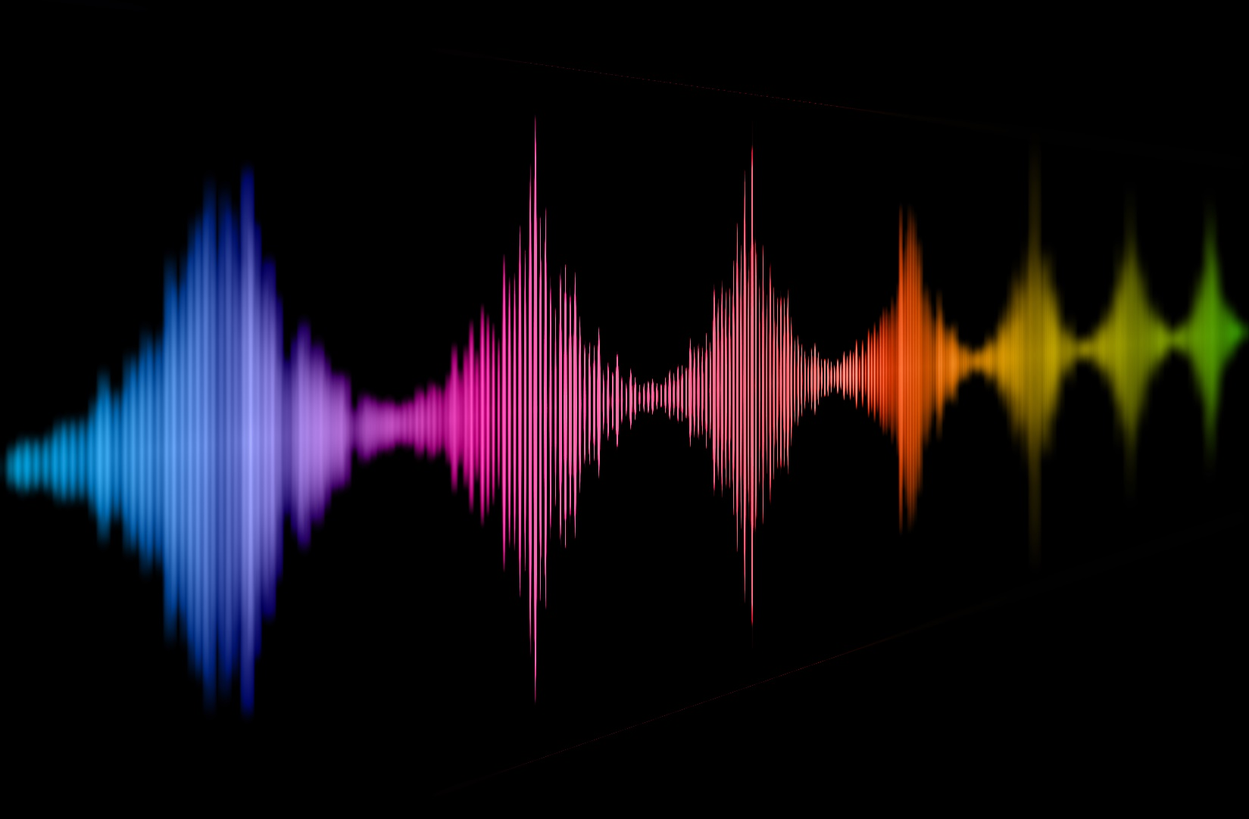


1st Workshop - MSCA Doctoral Network project
Stefan R. Schweinberger & Christine Nussbaum
MSCA Consortium Meeting, Carry-Le-Rouet 22.04.2023
Notes:
Hi all, first we are so disappointed to not be with you on site – we´d love to be in Carry le Rouet with you but it was the German train strike yesterday that kept us stuck here. Thanks so much to Pascal and Thierry for bringing us together!
Who are we – we´re a team that currently includes 5 postdocs and 8 PhD students in Jena –just under half of these work on voice perception specifically, but everyone in my team works in the wider area of person perception and human social interaction. For instance, in Jena we are one of six sites of the new government-funded German Center for Psychological Health - and the role of social interaction for mental health is a key topic of our Center. We are also part of a DFG priority program on visual communication – both of which were only established in 2022.
Jena has a population of about 110,000, and 470-year old full university with just under 20,000 students – there is big high tech optics industries and vision research, but also quite decent auditory research, and one of the things we established in 2015 is an interdisciplinary voice research unit.

Slide 2
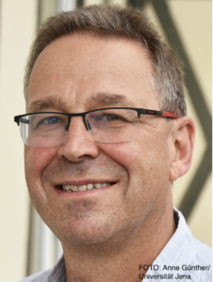
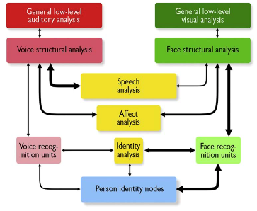
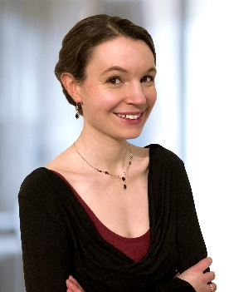
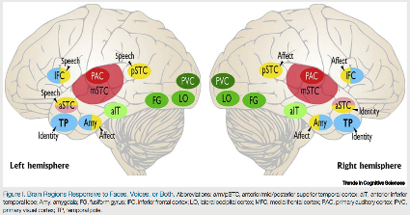
Department for General Psychology and Cognitive Neuroscience
Friedrich Schiller University Jena
Stefan R. Schweinberger
Voice perception
Face perception
Audiovisual integration
Hearing impairment
Individual differences
Christine Nussbaum
Perception of vocal emotions
Musicality and vocal emotion perception
Paramater-specific voice morphing
Voice Naturalness
Notes:
Christine just completed her PhD thesis and published in the field of voice emotion perception musicality but before she will show you our specific ideas for a possible contribution to the doctoral network, let me briefly say what else we do:
Voice perception – that includes both basic and clinical-applied research.
Face perception and audiovisual face-voice integration – one of our methods is EEG, and we study the neural timing of voice perception, and how this benefits from by the simultaneous availability information from the face.
We work with hearing impaired people and people with a cochlear implant, people with autism (we have a small but active autism research unit) and sometimes with neurological patients.
You all know that individual differences in voice perception skills are enormous, and so some of our work includes the development of tests for these skills. But individual differences in voice itself are equally impressive and so we also developed stimulus speaker databases. All these resources are open to the scientific community. For instance we have a published a large validated voice database of many young and old adult voices together with massive additional information about each individual speaker). You are all invited to use these resources yourself and if they can strengthen the case of the doctoral network proposal then this would be great. Christine to take over..

Slide 3
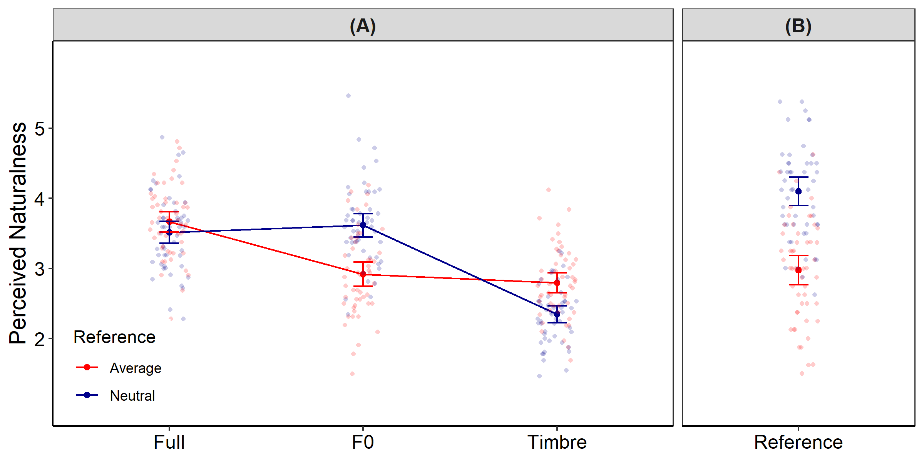
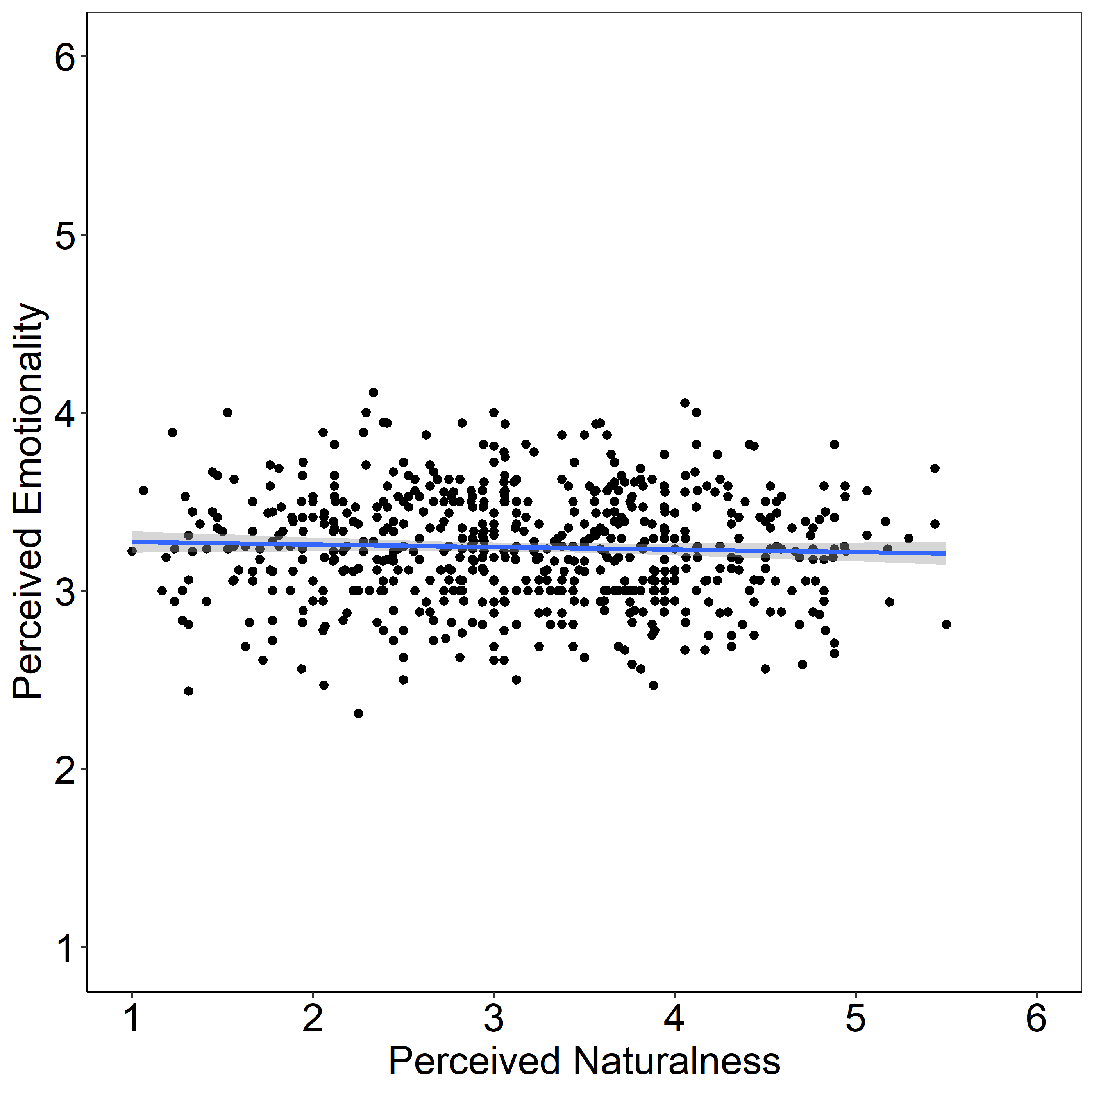
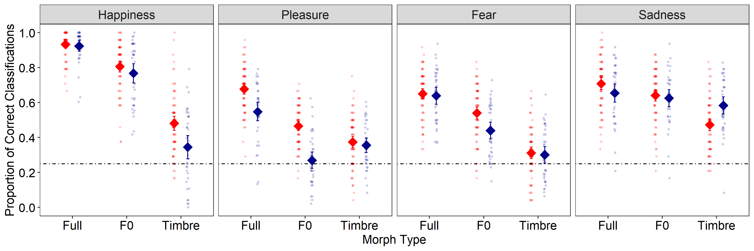
“[…] It is not that computers cannot talk: synthesized speech now reaches unprecedented levels of
intelligibility—but not naturalness. […]”
Nussbaum, C., Pöhlmann, M., Kreysa, H, & Schweinberger, S. R. (2023).
Perceived Naturalness of Emotional Voice Morphs [Cognition and Emotion, in revision]
Voice morphing affects voice naturalness…
… but emotion perception seems remarkably
robust against unnatural voice features

Slide 4
Potential Research Questions
How can we conceptualize voice naturalness? What are its acoustic determinants?
How does naturalness interact with the processing of other voice features (e.g. emotion, age, identity)?
How is processing in voice networks in the brain affected by non-natural voice features?
What determines perceived naturalness of synthesized/manipulated voices?
What are consequences of (non-)naturalness of synthesized voices?
Theory
Application
Notes:
Less a „fixed“ topic that we want to propose, but rather an offer to „form connections“
Super broad questions for now
Flexible: Kinship recognition / singing voice

